Slide 1
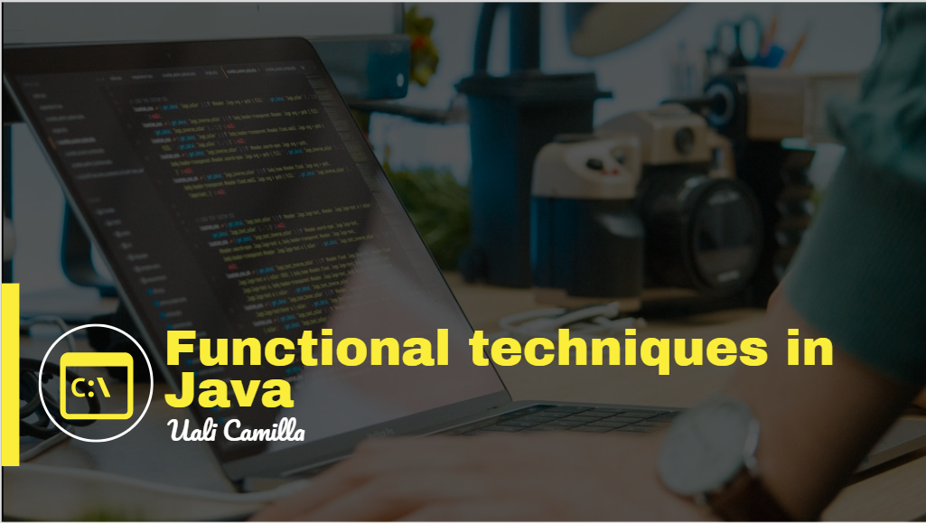

Slide 2
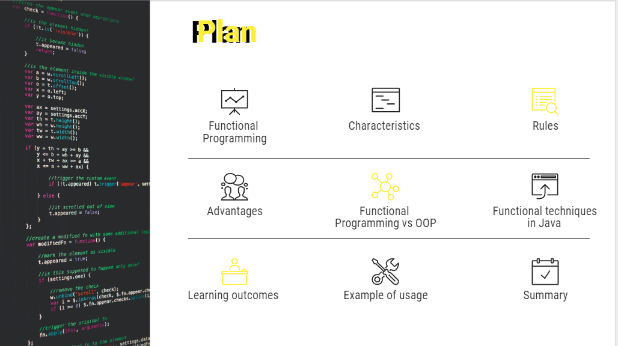

Slide 3
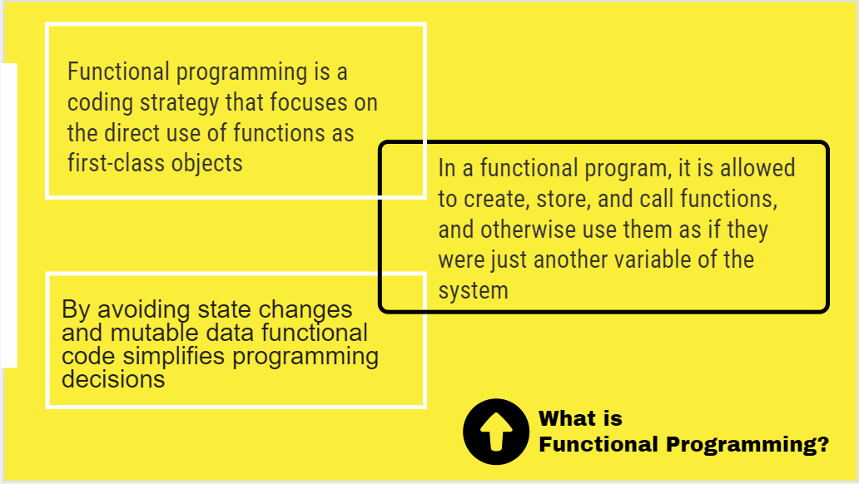

Slide 4
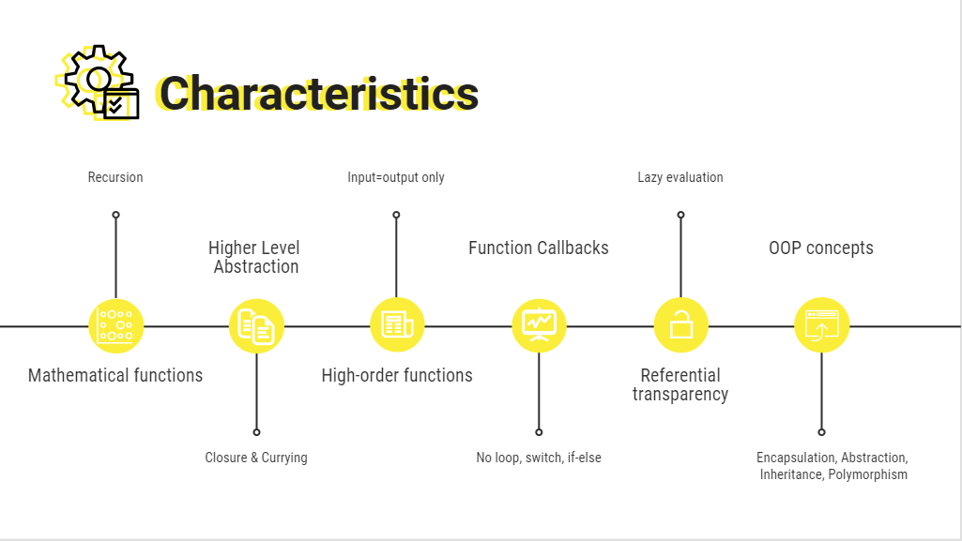

Slide 5
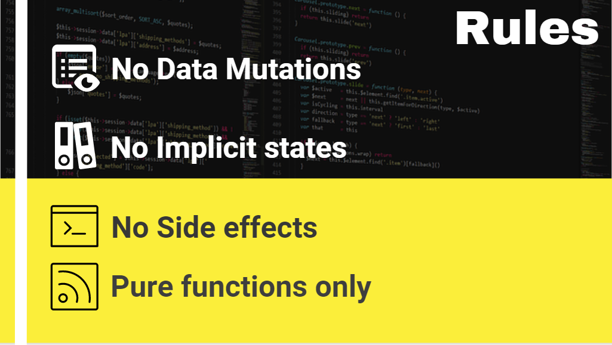

Slide 6
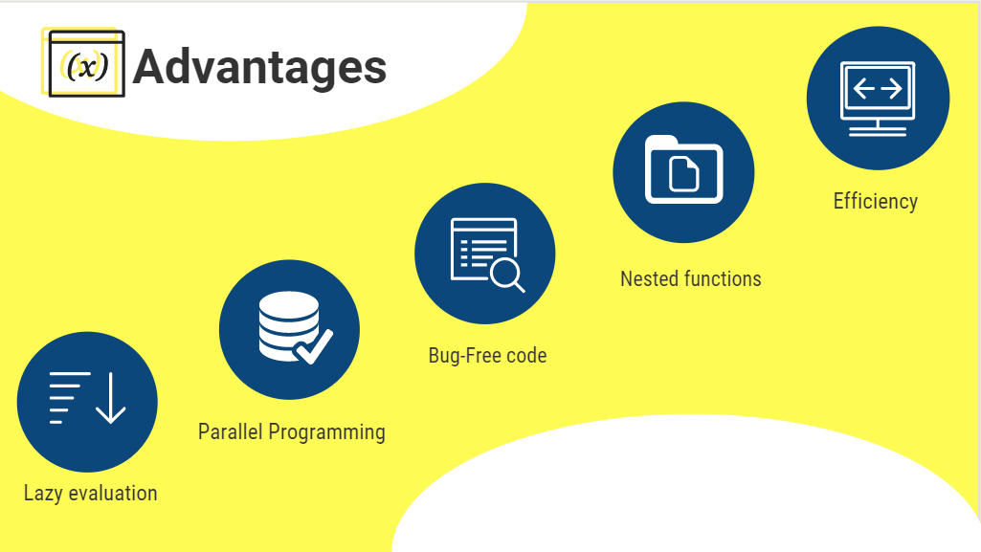

Slide 7
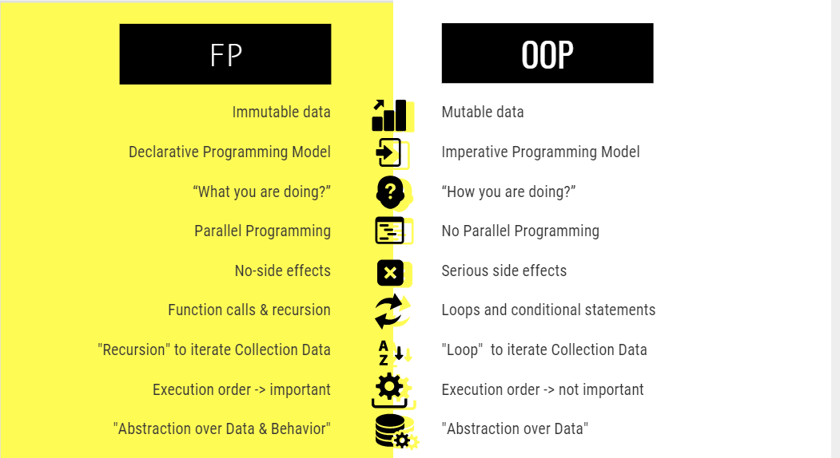

Slide 8
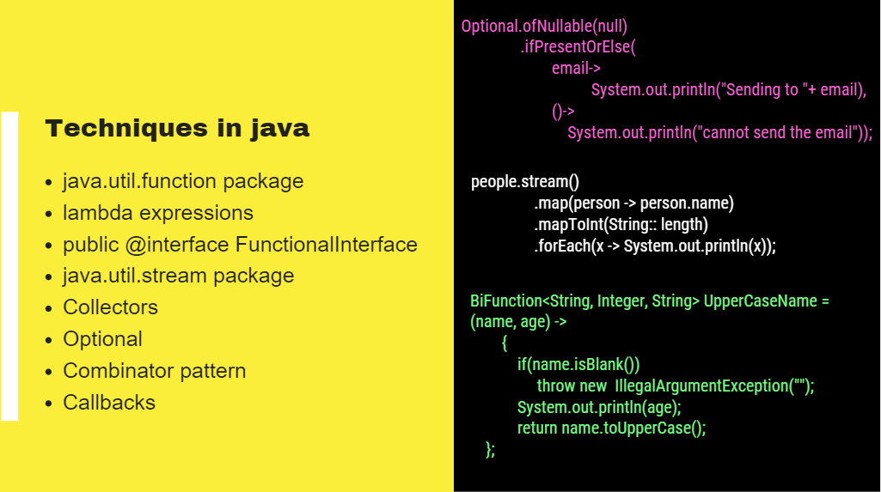

Slide 9
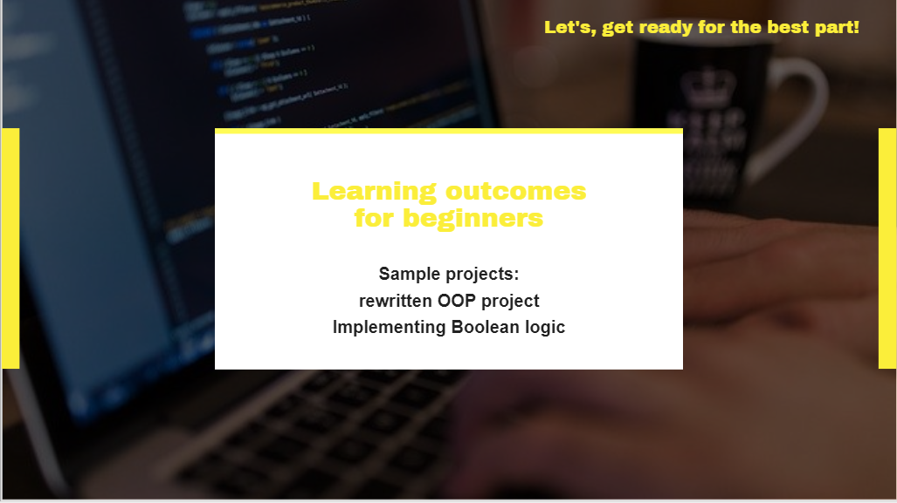

Slide 10
Learning outcomes

Slide 11
public class Callbacks { public static void main(String[] args) { hello("John", null, values -> { System.out.println("The lastname is not provided for " + values); }); hello2("John", null, () -> System.out.println("The lastname is not provided") ); } static void hello(String firtsname, String lastname, Consumer<String> callback){ System.out.println(firtsname); if (lastname != null) { System.out.println(lastname); } else{ callback.accept(firtsname); } } static void hello2(String firtsname, String lastname, Runnable callback){ System.out.println(firtsname); if (lastname != null) { System.out.println(lastname); } else{ callback.run(); } } }
Imperative vs. Declarative
// imperative approach static boolean isphonenumvalid (String phonenumber){ return phonenumber.startsWith("07") && phonenumber.length() == 11; } //declarative approach static Predicate<String> isphonenumvalidPredicate = phonenum -> phonenum.startsWith("07") && phonenum.length() == 11;
Java.util.function package:
static BiConsumer<customer, Boolean> greetCustomerConsumerv2 = (customer, showphonenum) -> System.out.println("Hello "+customer.customerName+ ", thanks for registering phone numbner " + (showphonenum ? customer.customerPhoneNumber : "**************"));
Stream:
List<Person> females2 = people.stream() .filter(person -> FEMALE.equals(person.gender)) .collect(toList()); females2.forEach(out::println);

Slide 12



OOP project

Slide 13
We create the easy OOP project with Book as object, Request and with Sockets
Write usual Client – Server classes, with no changes. After we change the ClientHandler and reply class to functional style. We just slightly edit the code
public class Book implements Serializable{ private Long id; private String name; private String author; public Book(Long id, String name, String author) { this.id = id; this.name = name; this.author = author; }
Create Book, Request, Reply classes.
The Reply() can be changed
public void start() { while (true) { try { System.out.println("waiting for a client..."); Socket socket = serverSocket.accept(); ClientHandler clientHandler = new ClientHandler(); clientHandler.clientHandling.apply(socket, books); clientHandler.start(); } catch (IOException e) { e.printStackTrace(); } } }
public class Request implements Serializable { private String code; private Book book; private Long id; public Request() {} public Request(String code) { this.code = code; } public Request(String code, Book book) { this.code = code; this.book = book; }
ServerApp
objectOutputStream.writeObject(request); reply2 reply = (reply2) objectInputStream.readObject(); List<Book> books = reply.getBooks();
ClientApp

Slide 14
final BiFunction<Socket, List<Book>, Predicate<Socket>> clientHandling = (socket, books) -> { this.socket = socket; try{ this.objectOutputStream = new ObjectOutputStream(socket.getOutputStream()); this.objectInputStream = new ObjectInputStream(socket.getInputStream()); } catch (IOException e) { e.printStackTrace(); } this.books = books; return null; };
Function<ObjectOutputStream, reply2> exception = reply -> { try { objectOutputStream.writeObject(reply); } catch (IOException e) { e.printStackTrace(); } return null; };
In ClientHandler we rewrite to function the method, and create our own exceptions with functional style.
But everything else stays pretty much the same. Only in other classes we will call the functions. Just for experiment we changes the reply class as well.
private String code; private List<Book> books; public void Reply() { this.books = new ArrayList<>(); } Consumer<String> setCode = code -> this.code = code; Supplier<String> getCode = () -> code; final Function<String, String> reply = code -> this.code = code; final Function<List<Book>, Book> SetAndGetBook = books -> (Book) (this.books = books); public List<Book> getBooks() { return books; } public reply2(OutputStream out) throws IOException { super(out); }
Optional<Request> readObject; try { Request request = null; readObject = Optional .ofNullable(request) .map((Request ret) -> { try { objectInputStream.readObject(); } catch (ClassNotFoundException | IOException e) { e.printStackTrace(); } return null; } );} catch (RuntimeException e){ throw e; }
Notes:
private String code; private List<Book> books; public void Reply() { this.books = new ArrayList<>(); } Consumer<String> setCode = code -> this.code = code; Supplier<String> getCode = () -> code; final Function<String, String> reply = code -> this.code = code; final Function<List<Book>, Book> SetAndGetBook = books -> (Book) (this.books = books); public List<Book> getBooks() { return books; } public reply2(OutputStream out) throws IOException { super(out); }

Slide 15
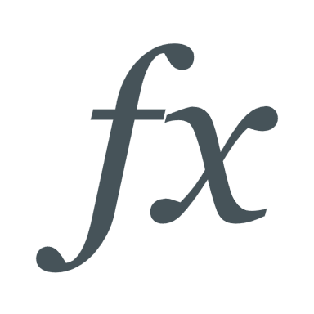
Discrete Math in functional java style

Slide 16
public class operators { static BiPredicate<Boolean, Boolean> and = (a, b) -> a && b; static BiPredicate<Boolean, Boolean> or = (a, b) -> a || b; static BiPredicate<Boolean, Boolean> implication = (a, b) -> a.equals(true) && b.equals(false) ? false : true; static Predicate<Boolean> negation = a -> !(a); static BiPredicate<Boolean, Boolean> Xor = (a, b) -> a ^ b; static BiPredicate<Boolean, Boolean> biConditional = (a, b) -> !(a ^ b); }
static BiPredicate<Boolean, Boolean> identityLaw = (p, q) -> q.equals(true) ? and.test(p, q) : or.test(p, q); static BiPredicate<Boolean, Boolean> domination = (p, q) -> q.equals(true) ? or.test(p, q) : and.test(p, q); static Function<Boolean, Boolean> idempotent = p -> p.equals(p) ? (and.test(p, p) || or.test(p, p)) : null; static Function<Boolean, Boolean> DoubleNegation = p -> !(!(p)); static Function<Boolean, Boolean> negationLawAnd = p -> and.test(p, !(p)); static Function<Boolean, Boolean> negationLawOr = p -> or.test(p, !(p)); static BiFunction<Boolean, Boolean, Boolean> commutativeAnd = (p, q) -> { Boolean A = and.test(p, q); if (A == and.test(q, p)) return A; else return false; }; static BiFunction<Boolean, Boolean, Boolean> commutativeOr = (p, q) -> { Boolean T = or.test(p, q); if (T == or.test(q, p)) { return T; } else return false; };
static TriFunction<Boolean, Boolean, Boolean, Boolean> distributiveAnd = (p, q, r) -> { Boolean T = and.test(p, or.test(q, r)); if (T == or.test(and.test(p, q), and.test(p, r))) return T; else return false; }; interface TriFunction<A,B,C,R> { R apply(A a, B b, C c); default <V> TriFunction<A, B, C, V> andThen( Function<? super R, ? extends V> after) { Objects.requireNonNull(after); return (A a, B b, C c) -> after.apply(apply(a, b, c)); } }

Slide 17
static TriConsumer<Boolean, Boolean, Boolean> implicationAndOrEq = (p, q, r) -> { Map<Boolean,Boolean> impAndOrEquivalence = new HashMap<>(); impAndOrEquivalence.put(implication.test(p, and.test(q, r)), and.test(implication.test(p, q), implication.test(p, r))); impAndOrEquivalence.put(implication.test(or.test(p,q), r), and.test(implication.test(p, r), implication.test(q, r))); impAndOrEquivalence.put(implication.test(p, or.test(q, r)), or.test(implication.test(p, q), implication.test(p, r))); impAndOrEquivalence.put(implication.test(and.test(p, q), r), or.test(implication.test(p, r), implication.test(q, r))); }; public interface TriConsumer<T, U, V> { void accept(T t, U u, V v); }
static BiConsumer<Boolean, Boolean> simplification = (p, q) ->{ if(implication.test(and.test(p,q), p)) System.out.println(p); };
static TriConsumer<Boolean, Boolean, Boolean> resolution = (p, q, r) ->{ if (implication.test(and.test(or.test(p,q), or.test(negation.test(p), r)), or.test(q, r))) System.out.println(or.test(q, r)); };
Rules of Inference
Logical Equivalences
static BiFunction<Boolean, Boolean,Boolean> biConditionalEq = (p, q) -> { Boolean biCondEq = biConditional.test(p, q); Boolean e1 = and.test(implication.test(p, q), implication.test(q, p)); Boolean e2 = biConditional.test(negation.test(p), negation.test(p)); Boolean e3 = or.test(and.test(p, q), and.test(negation.test(p), negation.test(p))); Boolean e4 = biConditional.test(p, negation.test(q)); List<Boolean> equations = List.of(e1, e2, e3); if(e4 == !biCondEq) return e4; else if ( equations.get(0) == biCondEq) return biCondEq; else return false; };
static BiPredicate<Boolean, Boolean> modusTonllens = (p, q) ->{ if(implication.test(and.test(negation.test(q), implication.test(p, q)), negation.test(p))) System.out.println("~p: "+!(p)); return implication.test(and.test(negation.test(q), implication.test(p, q)), negation.test(p)); }; static TriConsumer<Boolean, Boolean, Boolean> hypotheticalSyllogism = (p, q, r) ->{ if(implication.test(and.test(implication.test(p, q), implication.test(q, r)), implication.test(p, r))) System.out.println(implication.test(p, r)); };

Slide 18
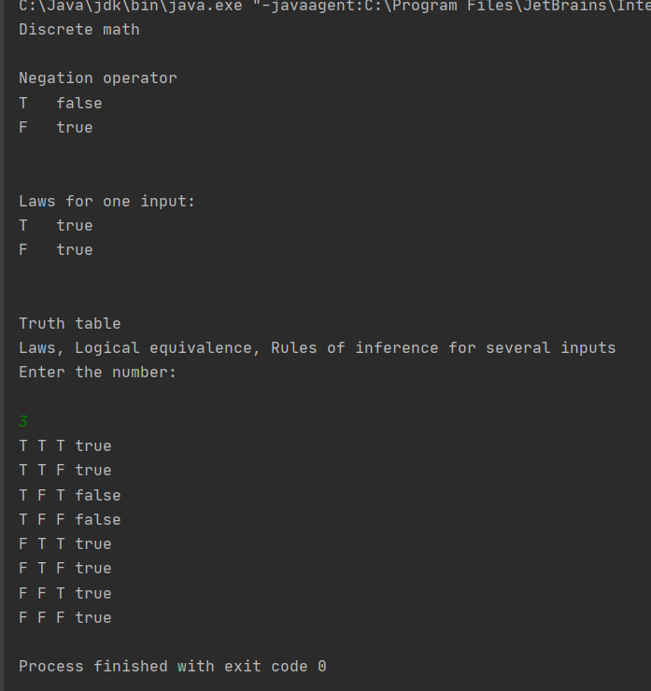
System.out.println("\n\nLaws for one input:"); for (x = 0; x < row; x++) { //T = identityLaw.test(p, false); //T = domination.test(p, false); //T = idempotent.apply(p); //T = DoubleNegation.apply(p); //T = negationLawAnd.apply(p); T = negationLawOr.apply(p); System.out.printf("%s\t%s%n", showValue(p), T); p = negation.test(p); } //testing for (int i = 0; i < rows; ++i) { for (int j = 0; j < columns; ++j) { // T = implication.test(matrix[i][0], matrix[i][1]); //T = absorptionOr.apply(matrix[i][0], matrix[i][1]); //T = biConditionalEq.apply(matrix[i][0], matrix[i][1]); //T = modusPonens.test(matrix[i][0], matrix[i][1]); //T = associativeAnd.apply(matrix[i][0], matrix[i][1], matrix[i][2]); System.out.print((matrix[i][j] ? "T" : "F") + " "); } System.out.println(T); }
In other class we test the written code, and we got the right results.
Here are negations operator, negation law with or statement, assosiacitve law with and statement.

Slide 19
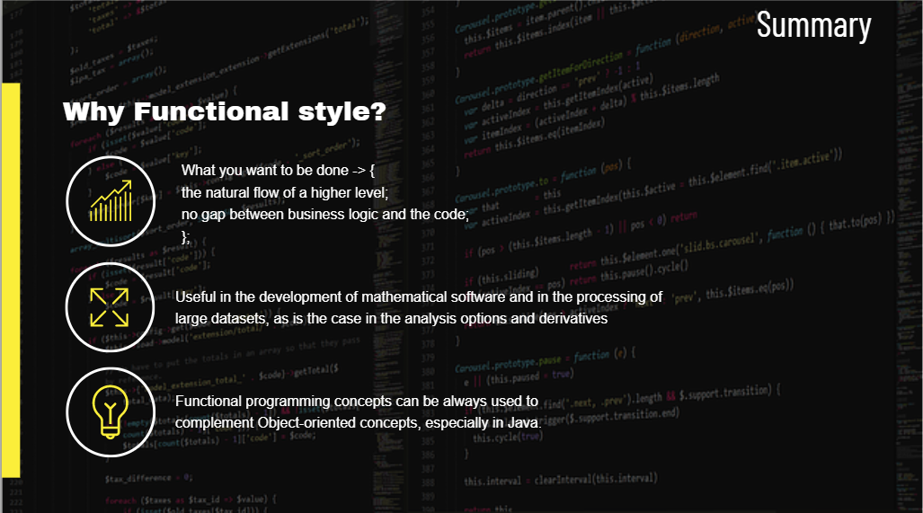

Slide 20
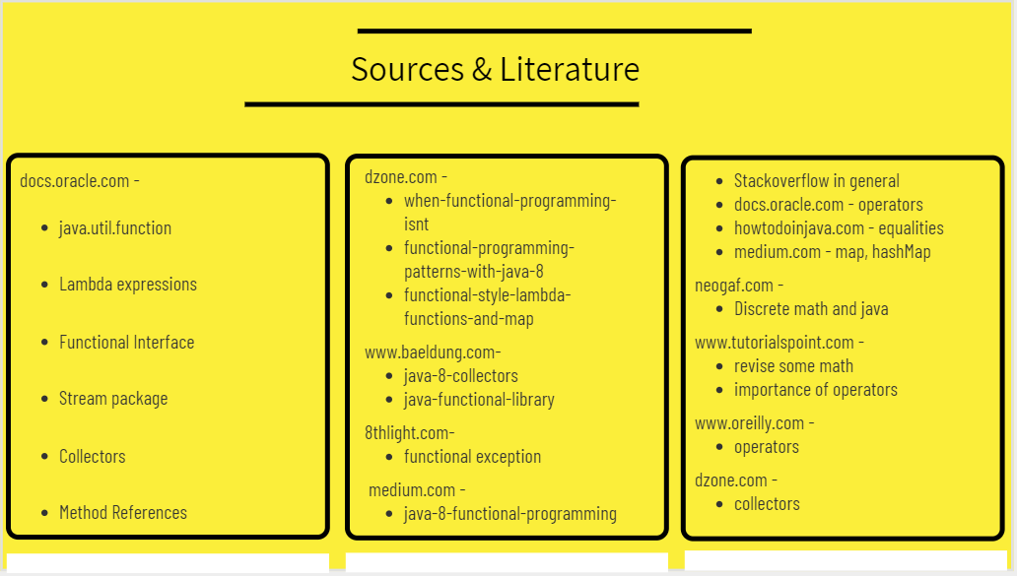

Slide 21
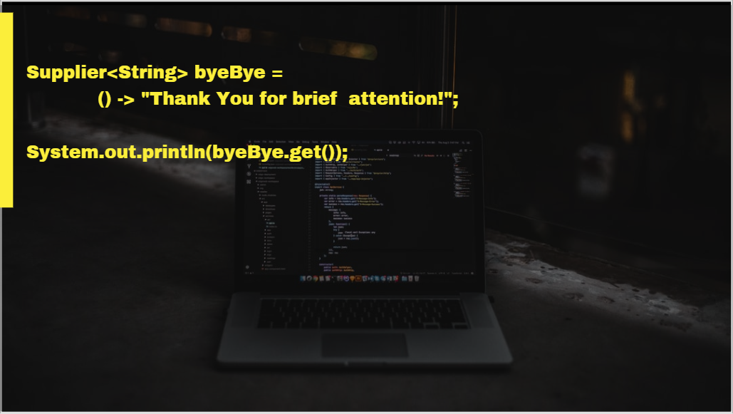
Thank You for brief attention!

